Slide 1


#Fit Safety as Standard
Safer Vehicles
14 June 2016 day 16th February
antonio.avenoso@etsc.eu
http://etsc.eu/projects/isafer/
@etsc_eu

Slide 2


























































ETSC Network

Slide 3
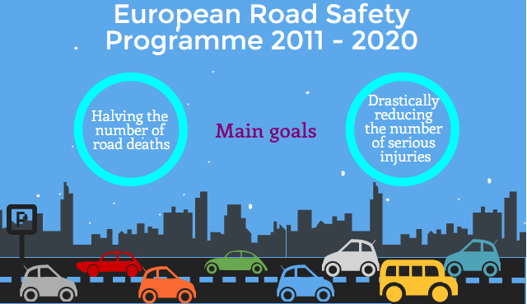
THE EU 2020 TARGET

Slide 4
26,300
Recorded killed as a consequence of road collisions in 2015 in the EU28

Slide 5
+/-135,000*
seriously injured in road traffic in the EU in 2014
*As MAIS3+. Estimation from the European Commission based on data sent by Member States

Slide 6
ROAD SAFETY COMPETENCES OF THE EU
Vehicle safety standards: exclusive competence (Article 114 of the EU Treaty)
Infrastructure safety and driver behaviour: shared competence - principle of subsidiarity (Article 5.3 of the EU Treaty).
Figures would have been significantly higher without vehicle safety measures already taken by the EU
Last revision of the EU common vehicle safety rules in 2009 with the General Safety Regulation 661/2009 and Pedestrian Protection Regulation 78/2009

Slide 7
VEHICLE SAFETY - ETSC PRIORITIES linked to the three main killers
  Overridable assisting ISA on all vehicles
  Alcohol interlocks on professional vehicles and a standard interface for all vehicles
  Seat belt reminders for all passenger seats
  Automated Emergency Braking

Slide 8
We know a lot about speed and risk
“Speed remains a very important risk factor. It has a greater effect on the number of accidents and injury severity than almost all other known risk factors.”
Rune Elvik, The Power Model of the relationship between speed and road safety: Update and new analyses (2009)
Notes:
Note sure about the “almost” qualification.

Slide 9
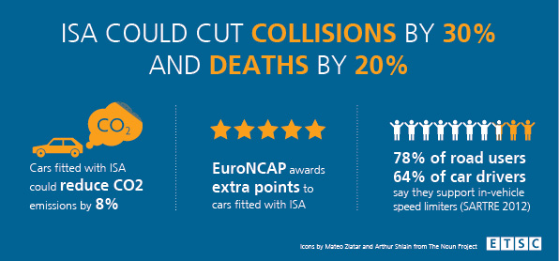
INTELLIGENT SPEED ASSISTANCE

Slide 10
GB accidents saved over time for the Market Driven scenario
The importance of regulation
ISA GB trial 2001-2006
Oliver Carsten, reference

Slide 11
GB accidents saved over time for the Regulation scenario
ISA GB trial 2011-2006
Oliver Carsten, reference

Slide 12
Comparison of predicted outcomes
ISA GB trial 2011-2006
Oliver Carsten, reference
GB collisions from 2010 to 2070
 | Slight collisions | Serious collisions | Fatal collisions
Market Driven scenario | 4% | 8% | 13%
Regulation scenario | 15% | 25% | 30%
Benefit to cost ratios (accidents + fuel + CO₂):
  Market Driven scenario 3.4
  Regulation scenario 7.4
  Much of the potential of ISA, e.g. to replace traditional and costly traffic calming, was not counted
Notes:
Interpretation of scenario analysis:
Both scenarios are winners
The harder the push for ISA and the “stronger” the system, the greater the benefits
Shows the importance of regulation
Much of the potential of ISA, e.g. to replace traditional and costly traffic calming, was not counted

Slide 13
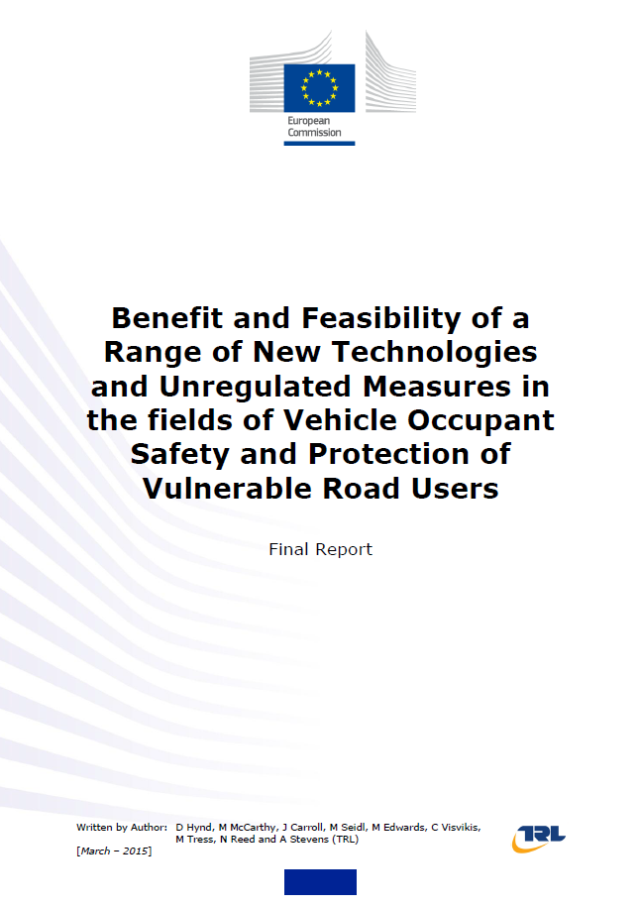
Evaluation study report
The European Commission commissioned the Transport Research Laboratory (TRL, in the UK) to:
assess feasibility of a range of new technologies
for possible inclusion in the revised regulations on vehicle safety (General Safety and Pedestrian Protection)
Report published in March 2015

Slide 14
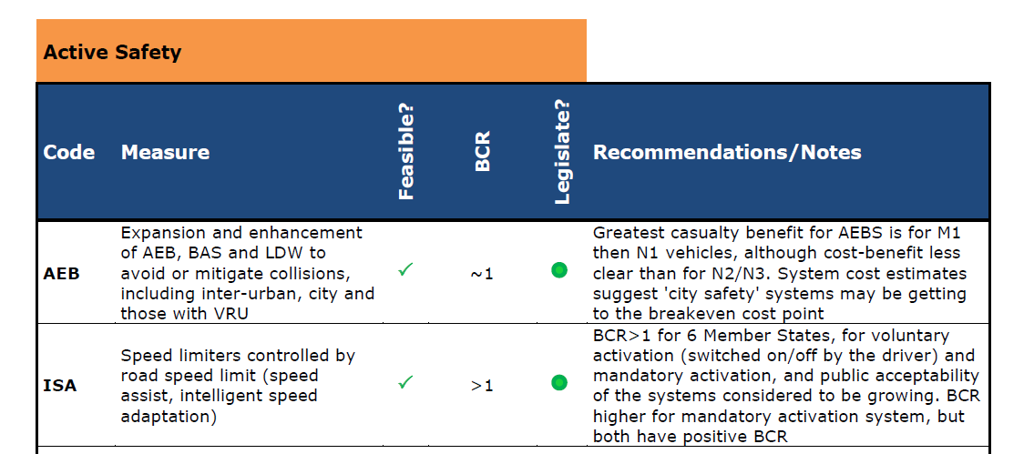
TRL Evaluation study on GSR
ISA Positive Benefit / cost ratio (BCR)
Public acceptability growing
Rated green for legislation
Notes:
N1, N2, N3: trucks

Slide 15




To contribute to reducing speed-related road deaths and injuries across Europe.
Promoting the use of Intelligent Speed Assistance (ISA) at European and national level.

Slide 16
CONCLUSIONS
ISA is a well-proven technology with very significant safety benefits
Regulation is necessary to maximise the impact of ISA on casualties reduction
A legally-binding tool represents the most direct and effective measure the EU has at its disposal to further reduce road casualties.
Co-decision with European Parliament and Council: we need allies!
#SafetyAsStandard

